Slide 1

TOTAL TECHNOLOGY
REPORTLAB COMPLETE TUTORIAL
Table in Reportlab
Create MULTI PAGE table from csv file
Tutorial 32

Slide 2
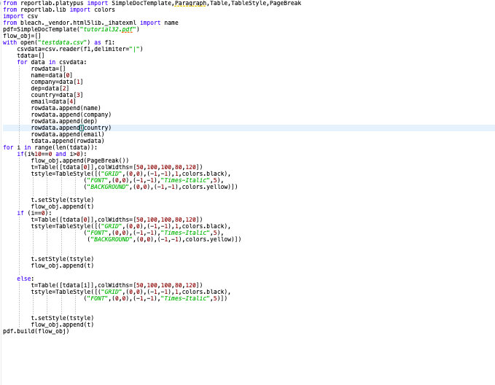
How to create multi page table from csv file
TOTAL TECHNOLOGY

